Slide 1
Parsing with Context Free Grammars

Slide 2
Syntactic Parsing
Syntactic parsing is the task of recognizing a sentence and assigning a syntactic structure to it
This lecture focuses on the kind of structures assigned by the context-free grammars
In addition, parsing is an important intermediate stage of representation for semantic analysis, and thus plays an important role in applications like machine translation, question answering, and information extraction
In syntactic parsing,the parser can be viewed as searching through the space of all possible parse trees to find the correct parse tree for the sentence

Slide 3
Book that flight
A miniature English Grammar and Lexicon- Fig 1
Correct Parse Tree- Fig 2

Slide 4
cntd
The goal of a parsing search is to find all trees whose root is the start symbol S, which cover exactly the words in the input.
The final parse tree, it must have one root, which must be the start symbol S and there must be three leaves, and they must be the words book, that, and flight
There are clearly two kinds of constraints that should help guide the search
One kind of constraint comes from the data, i.e. the input sentence itself
The second kind of constraint comes from the grammar
These two constraints give rise to the two search strategies underlying most parsers: top-down or goal-directed search and bottom-up or data-directed search.

Slide 5
Top Down Parsing
A top-down parser searches for a parse tree by trying to build from the root node S down to the leaves.
The algorithm starts by assuming the input can be derived by the designated start symbol S.
The next step is to find the tops of all trees which can start with S, by looking for all the grammar rules with S on the left-hand side. In the grammar in Figure A, there are three rules that expand S, so the second ply, or level, of the search space in Figure 3 has three partial trees
Figure 3

Slide 6
cntd
We next expand the constituents in these three new trees, just as we originally expanded S.
The first tree tells us to expect an NP followed by a VP, the second expects an Aux followed by an NP and a VP, and the third a VP by itself.
Trees are grown downward until they eventually reach the part-of-speech categories at the bottom of the tree
At this point, trees whose leaves fail to match all the words in the input can be rejected, leaving behind those trees that represent successful parses.
In Figure 3, only the 5th parse tree (the one which has expanded the rule VP ->Verb NP) will eventually match the input sentence Book that flight

Slide 7
Bottom-Up Parsing
In bottom-up parsing, the parser starts with the words of the input, and tries to build trees from the words up, again by applying rules from the grammar one at a time
The parse is successful if the parser succeeds in building a tree rooted in the start symbol S that covers all of the input
Figure 4 show the bottom-up search space, beginning with the sentence Book that flight
The parser begins by looking up each word (book, that, and flight) in the lexicon and building three partial trees with the part of speech for each word
But the word book is ambiguous; it can be a noun or a verb.
Thus the parser must consider two possible sets of trees.
The first two plies in Figure 10.4 show this initial bifurcation of the search space.

Slide 8
Bottom up Search Space for the sentence Book that flight

Slide 9
cntd
Each of the trees in the second ply are then expanded.
In the parse on the left (the one in which book is incorrectly considered a noun), the
Nominal->Noun rule is applied to both of the Nouns (book and flight).
This same rule is also applied to the sole Noun (flight) on the right, producing the trees on the third ply.
In general, the parser extends one ply to the next by looking for places in the parse-in-progress where the right-hand-side of some rule might fit.
This contrasts with the earlier top-down parser, which expanded trees by applying rules when their left-hand side matched an unexpanded nonterminal.
Thus in the fourth ply, in the first and third parse, the sequence Det Nominal is recognized as the right-hand side of the NP->Det Nominal rule.

Slide 10
cntd
In the fifth ply, the interpretation of book as a noun has been pruned from the search space.
This is because this parse cannot be continued: there is no rule in the grammar with the right-hand side Nominal NP.
The final ply of the search space is the correct parse tree
Make sure you understand which of the two parses on the penultimate ply gave rise to this parse.

Slide 11
Features and unification
We introduce the idea that grammatical categories like VPto, Sthat, Non3sgAux, or 3sgNP, as well as the grammatical rules like S->NP VP that make use of them, should be thought of as objects that can have complex sets of properties associated with them
The information in these properties is represented by constraints, and so these kinds of models are often called constraint-based formalisms
Noun phrases like this flight and those flights can be distinguished based on whether they are singular or plural.
This distinction can be captured if we associate a property called NUMBER that can have the value singular or plural, with appropriate members of the NP category.
Given this ability, we can say that this flight is a member of the NP category and, in addition, has the value singular for its NUMBER property.
This same property can be used in the same way to distinguish singular and plural members of the VP category such as serves lunch and serve lunch.

Slide 12
Feature Structures
Feature structures are sets of feature-value pairs, where features are unanalyzable atomic symbols drawn from some finite set, and values are either atomic symbols or feature structures.
Such feature structures are traditionally illustrated with the following kind of matrix-like diagram

Slide 13
cntd
To be concrete, let us consider the number property discussed above.
To capture the number property, we will use the symbol NUMBER to designate this grammatical attribute, and the symbols SG and PL to designate the possible values it can take on in English.
A simple feature structure consisting of this single feature would then be illustrated as follows.
Adding an additional feature-value pair to capture the grammatical notion of person leads to the following feature structure

Slide 14
cntd
Next we can encode the grammatical category of the constituent that this structure corresponds to through the use of the CAT feature
For example, we can indicate that these features are associated with a noun phrase by using the following structure
This structure can be used to represent the 3sgNP category to capture a restricted subcategory of noun phrases
The corresponding plural version of this structure would be captured as follows

Slide 15
Cntd
Features can also have other feature structures as their values
This is to bundle a set of feature-value pairs together for similar treatment
As an example the NUMBER and PERSON features are often lumped together since grammatical subjects must agree with their predicates in both their number and person properties
This lumping together can be captured by introducing an AGREEMENT feature that takes a feature structure consisting of the NUMBER and PERSON feature-value pairs as its value
Introducing this feature into our third person singular noun phrase yields the following kind of structure

Slide 16
UNIFICATION OF FEATURE STRUCTURES
The two principal operations on feature structures are
Merging the information content of two structures
Rejecting the merger of structures that are incompatible
A single computational technique, called unification, suffices for both of these purposes

Slide 17
Simple Application of the unification operator

Slide 18
An equality check complicated by the presence of a reentrant structure in the first argument

Slide 19
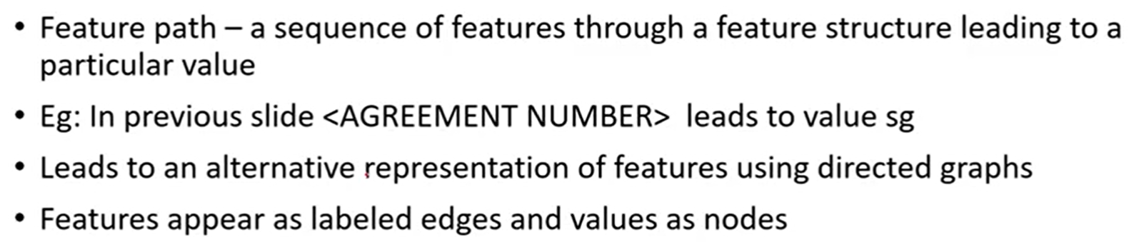
Feature Path

Slide 20
A directed graph notation for feature structure

Slide 21
Feature Structures in the Grammar
Our next step, is to specify a way to integrate feature structures and unification operations into the specification of a grammar.
This can be accomplished by augmenting the rules of ordinary context-free grammars with attachments that specify feature structures for the constituents of the rules, along with appropriate unification operations that express constraints on those constituents.
From a grammatical point of view, these attachments will be used to accomplish the following goals:

Slide 23
Notation to denote grammar augmentations
The notation <βi feature path>denotes a feature path through the feature structure associated with the βi component of the context-free part of the rule.
The first style of constraint specifies that the value found at the end of the given path must unify with the specified atomic value.
The second form specifies that the values found at the end of the two given paths must be unifiable.

Slide 24
cntd

Slide 25
Probabilistic Parsing
Due to the prevalence of ambiguity, probabilistic parsers can play an important role in most parsing or natural language understanding task
Another important use of probabilistic grammars is in language modeling for speech recognition or augmentative communication.
The simplest augmentation of the context-free grammar is the Probabilistic Context-Free Grammar (PCFG), also known as the PCFG or Stochastic Context- SCFG Free Grammar (SCFG)

Slide 26
A PCFG, a probabilistic augmentation of the miniature English Grammar and Lexicon

Slide 27

cntd
A probabilistic context-free grammar augments each rule in P with a conditional probability:
A PCFG is thus a 5-tuple G = where D is a function assigning probabilities to each rule in P.
This function expresses the probability p that the given nonterminal A will be expanded to the sequence
It is often referred to as
$$A→β[p]$$

Slide 28
cntd
Formally this is conditional probability of a given expansion given the left-hand-side nonterminal A
A PCFG can be used to estimate a number of useful probabilities concerning a sentence and its parse-tree(s).
For example a PCFG assigns a probability to each parse-tree T (i.e. each derivation) of a sentence S.
This attribute is useful in disambiguation.
For example, consider the two parses of the sentence “Can you book TWA flights” (one meaning ‘Can you book flights on behalf of TWA’, and the other meaning ‘Can you book flights run by TWA’) shown in Figure
The probability of a particular parse T is defined as the product of the probabilities of all the rules r used to expand each node n in the parse tree:

Slide 29
cntd
The resulting probability P(T,S) is both the joint probability of the
parse and the sentence, and also the probability of the parse P(T).
First, by the definition of joint probability
But since a parse tree includes all the words of the sentence, P(S|T) is 1.
1. Thus
The probability of each of the trees in the following figure can be computed by multiplying together each of the rules used in the derivation.
For example, the probability of the left tree (call it Tl) and the right tree (12.2b or Tr) can be computed as follows

Slide 31
cntd

Slide 32
cntd
Thus this parse would correctly be chosen by a disambiguation algorithm which selects the parse with the highest PCFG probability.
The disambiguation algorithm picks the best tree for a sentence S out of the set of parse trees for S
We want the parse tree T which is most likely given the sentence S.
Furthermore, since we showed above that P(T,S)=P(T) the final equation for choosing the most likely parse simplifies to choosing the parse with the highest probability:

Slide 33
Lexicalized PCFG
Lexicalization of a tree bank
Lexicalized Context free grammars
Parameterization in lexicalized context free grammars

Slide 34
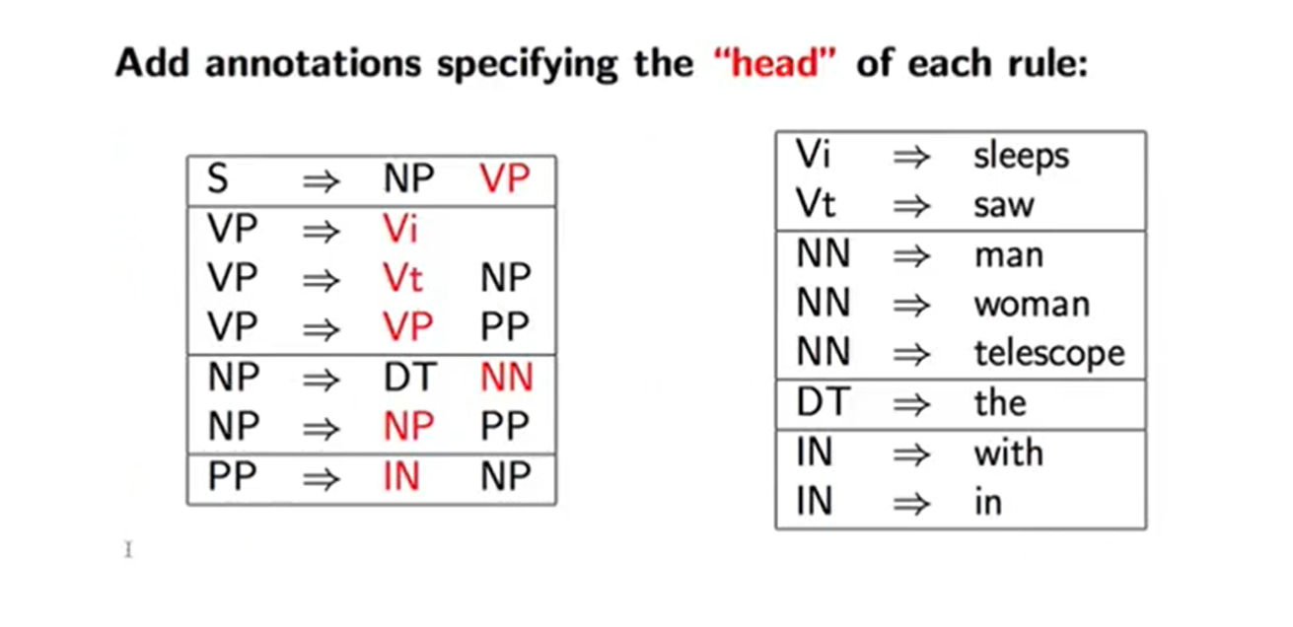
Heads in Context Free Rules

Slide 35
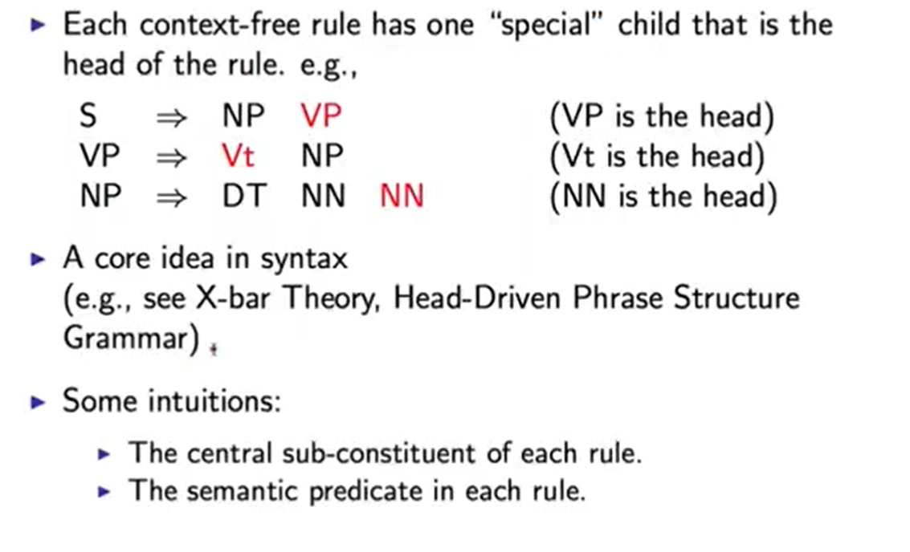
More about Heads

Slide 36
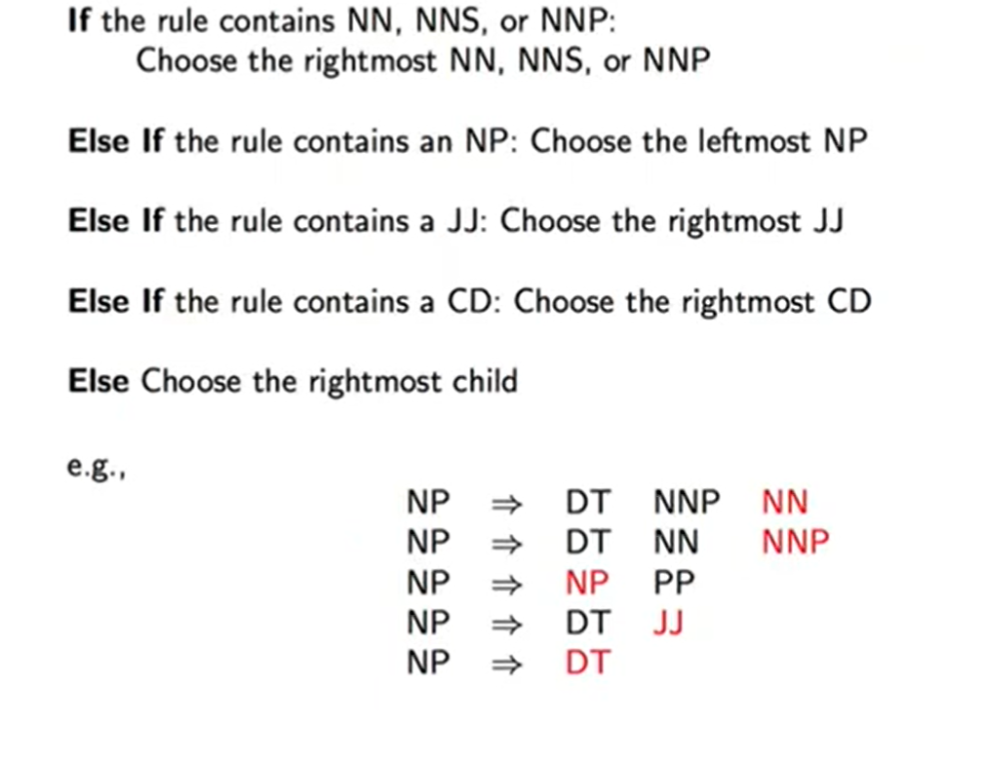
Rules which recover heads: An example for NPs

Slide 37
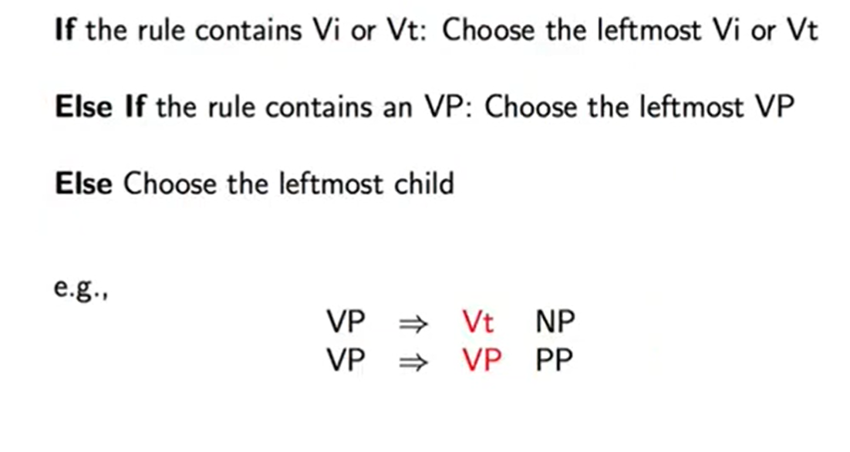
Rules which recover heads: An example for VPs

Slide 38
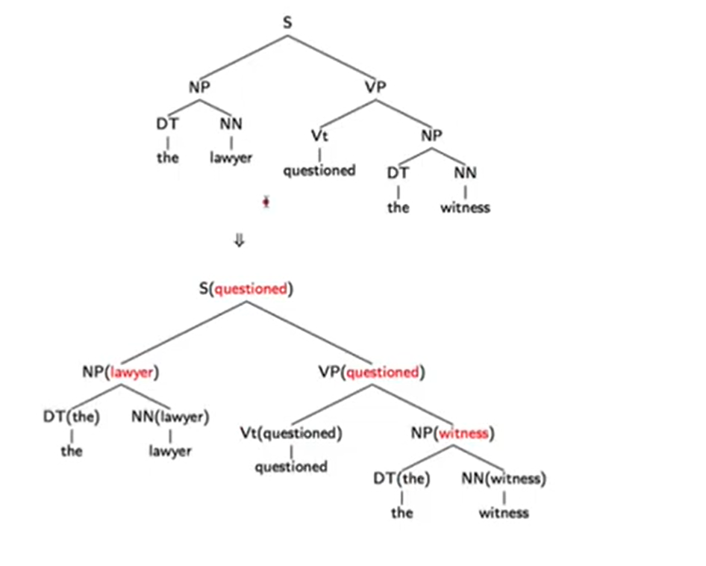
Adding Headwords to Trees

Slide 39
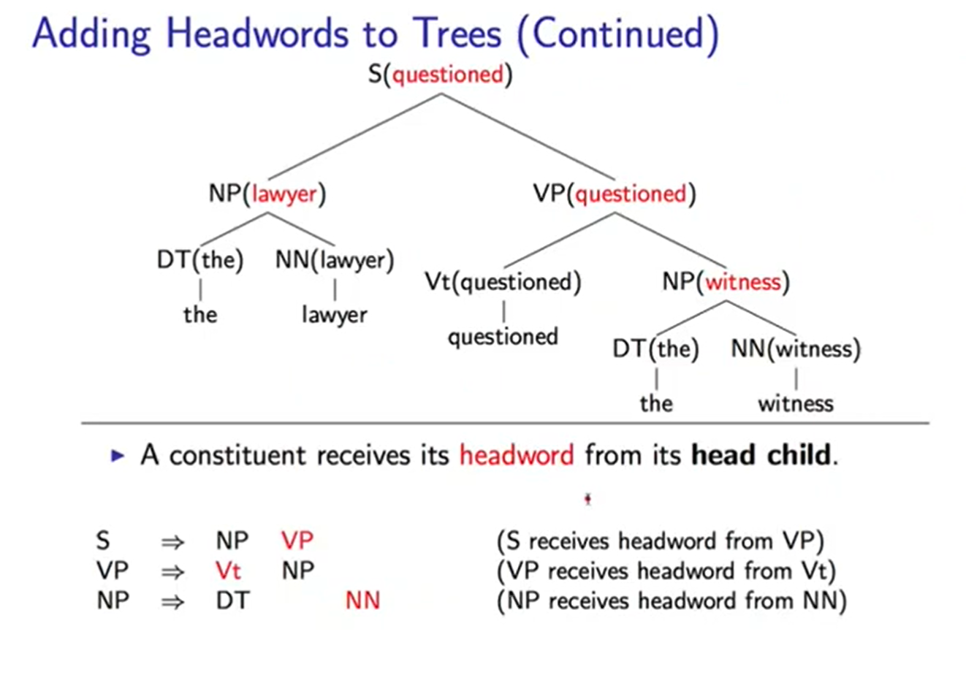
Adding Headwords to Trees-cntd

Slide 40
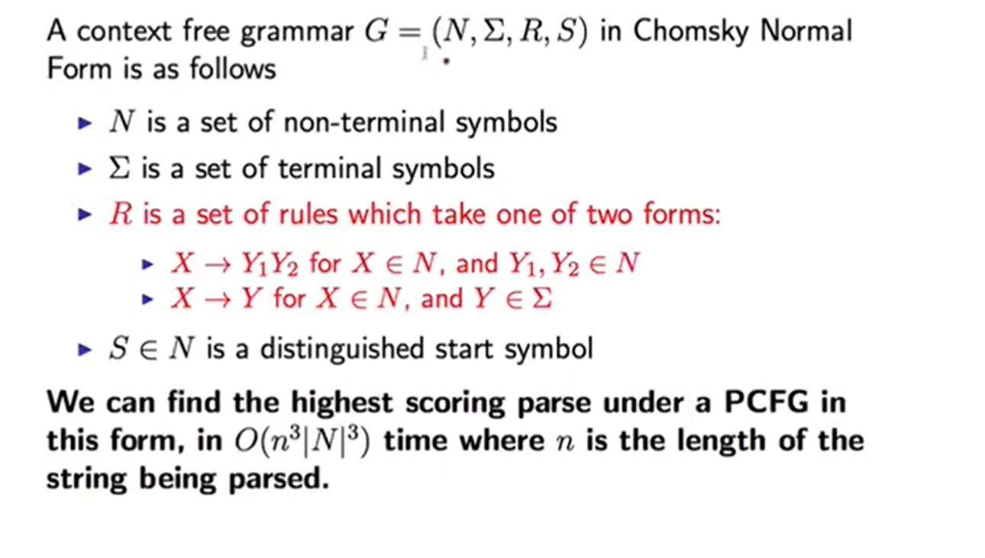
Chomsky Normal Form

Slide 41
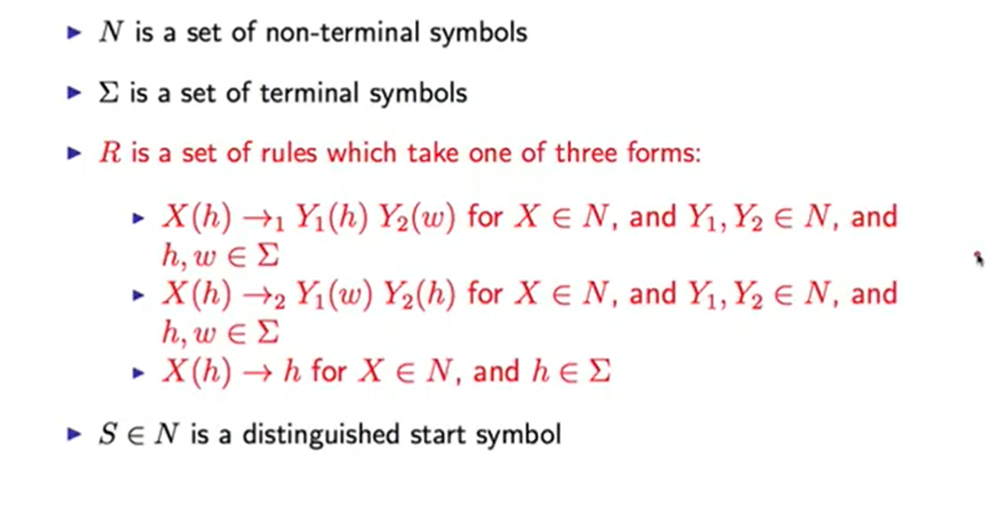
Lexicalized Context Free Grammars in Chomsky Normal Form

Slide 42
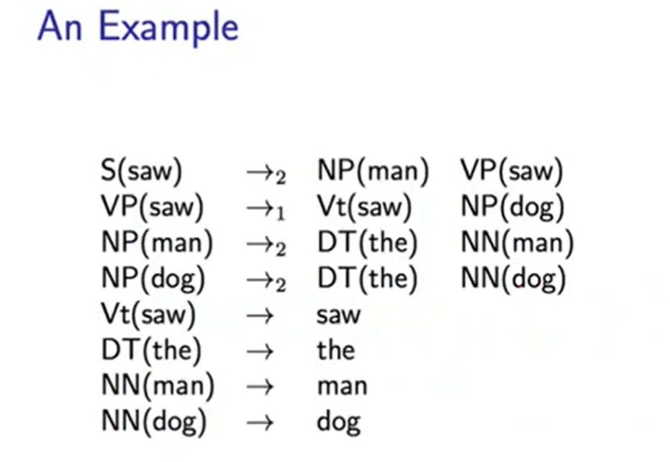
An Example

Slide 43
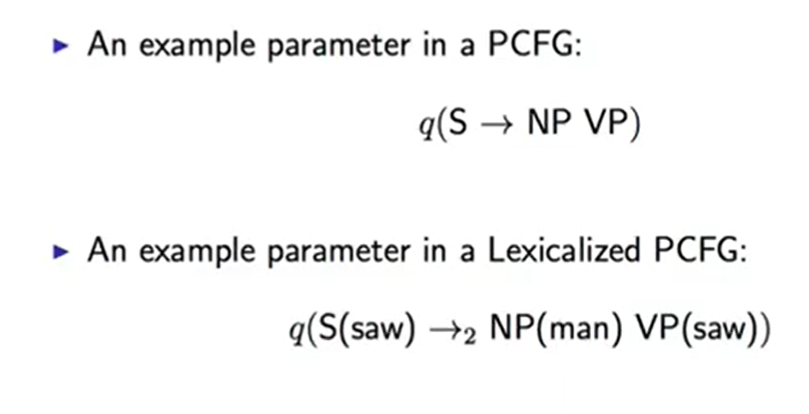
Parameters in Lexicalized PCFG

